Slide 1

Veteran Predictive Model
Medicare Business Intelligence and Analytics Solutions (MCR BI&A Solutions)
September 2020

Slide 2

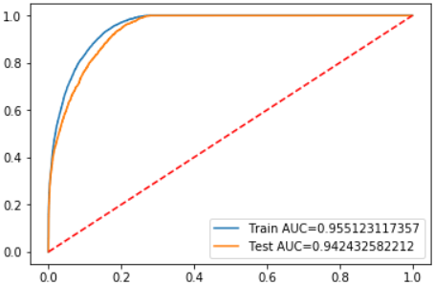
Veteran Predictive Model Frame Work
1
Key Objectives
Identify veteran members to get their consents to collect chart from VA system, which would help to improve clinical quality and management
Identify key drivers and cohorts of veteran members for campaigns that focus on improving HEDIS and Patient Safety measures.
Process Flow
Step 1 – Predictive Model
Step 2- Prediction
Step 3- Validation/ Insights
Predictive Model – Likelihood of being a veteran
Who is a veteran?
Generating veteran likelihood scores
Membership Cohort – 2020 MAPD active members
Derive various attributes at the members level across claims, HEDIS and Patient Safety data, and clinical data
Generate veteran likelihood scores using the machine learning model
Identify and stratify
Veterans would be the members who were predicted in the top 3 deciles
Validate against actual veteran status
Collaborate with call center to run a pilot in prioritized markets based on predicted likelihood scores to verify veteran status, run effectiveness test against predicted veterans.
Identify and evaluate the key drivers for veterans to close the gaps for HEDIS and Patient Safety.
Perform effective intervention based on the opportunities identified
Leverage data include VBE survey, SOP Campaigns, and Enrollment data, etc..
Develop machine learning models using advanced ensemble algorithms
Multi dimensional attributes: HEDIS and Patient Safety measures, Clinical Utilization , Disease Conditions , Member Experience , Demographics
Notes:
Tables:

Slide 3









Veteran Modeling Strategy
2
Data Sampling
Attributes Selected for the Model
MAPD Individual Members
Data Sources
1.6 millions
All 2020 MAPD IVL Members
Measured at member level
Identified Veterans
Nonveterans
Selected 9,300 Identified Veterans plus 30,000 randomly selected Nonveterans from the Top 5 Veterans Contracts
9,300
30,000
Value-Based Enrollment (VBE) Survey
SOP Campaign Data
Enrollment Data
Medical & Pharmacy Claims
HEDIS and Patient Safety Data
Member Interaction Tables(call, and grievance)
Member Demographics
Member Experience- Call and Grievances
Primary Care and Specialist Utilization
From
VBE
From SOP/
Enrollement
Randomly Selected from VBE
Randomly Selected from
Top 5 VA Contracts
In the final modeling dataset, Approximately, 55% fo the members are from VBE suvey
5,000
Comorbidity
4,300
16,500
13,500
Limitation
Medical Cost
81% of the 9,300 identified veterans are newly enrolled members with tenure less than 8 months (as of 2020 August), and this is unavoidable due to the source. In comparison, the general Individual MAPD population only has 36% newly enrolled members. This unbalanced proportion in tenure will decrease accuracy in predicting veteran members.
55% of the nonveterans sampled for the model can be confirmed as nonveterans from VBE survey. However the rest of nonveterans sampled from the top 5 veteran contracts can not be confirmed due to lack of information. We assume these members as nonveteran for the model which might lead to unreliability for the prediction.
The current model has an accuracy of 94% for the testing group as of 06/2020, however, this prediction rate could drop as we score the future membership due to the above 2 limitations identified.
HEDIS and Patient Safety Compliance
Drug Utilization
Demographics - Age , Gender, Tenure, Disability
Notes:
Tables:

Slide 4

Veteran Model Performance – Test Dataset
3
Distribution of Veterans and Nonveterans Across Deciles
Veteran Capture Rate Across Top 2-5 Deciles
Veterans
Deciles | Population | Actual Veterans | Actual Veteran Rate
1 | 1,194 | 1,057 | 88.52%
2 | 1,193 | 737 | 61.73%
3 | 1,193 | 561 | 47.02%
4 | 1,193 | 372 | 31.18%
5 | 1,193 | 57 | 4.77%
6 | 1,193 | 0 | 0.00%
7 | 1,193 | 0 | 0.00%
8 | 1,193 | 0 | 0.00%
9 | 1,193 | 0 | 0.00%
10 | 1,194 | 0 | 0.00%
Overall | 11,932 | 2,769
Likely to be a veteran
The model accuracy rate is 94.0%.
Top 2 Deciles capture 65% of the veteran.
Top 3 Deciles capture 85% of the veteran.
Top 4 Deciles capture 98% of the veteran.
Top 5 Deciles capture 100 % of the veteran.
Not likely to be a veteran

Slide 5
Top Key Drives to Identify Veterans
4
Positive Veteran Key Drivers (Importance)
1.6X to be a Veteran
1.2X to be a Nonveteran
Every additional 5 miles that
the member lives away from the VA hospital
Every additional year that
the member enroll with the plan
1.3X to be a Veteran
2.3X to be a Nonveteran
Every 5 additional years of age
With breast cancer screening
noncompliant
1.9X to be a Veteran
1.4X to be a Nonveteran
Negative Veteran Key Drivers (Importance)
With colorectal cancer
noncompliant
Two fewer distinct drug taken
1.6X to be a Veteran
2.3X to be a Nonveteran
With disabilities
With Primary Care Physician assigned
Note:
Top drivers are based on the test dataset contains sample active members as of 06/2020
Veterans status were self reported in survey, no third-party verification for their veteran status

Slide 6
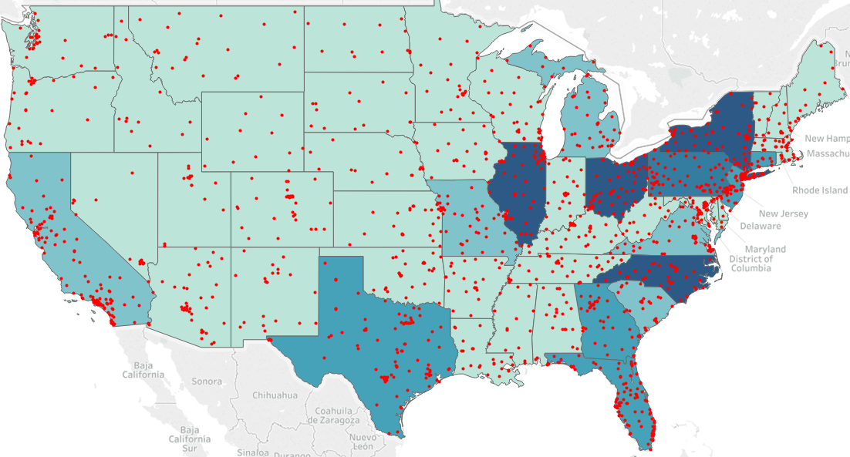
Target Population #1 – Top 3 Deciles (Top 30%)
5
All Identified Veterans(N=475,000)
Map: Top 3 Decile Membership by State (VA Facilities)*
Top 5 States
Gender
Males
Females
Tenure Months
Age Group
Members in the top 3 deciles resided in the northeast region, Illinois and North Carolina.
In those regions, there are numbers of VA hospitals, and it is more likely that veterans use VA facilities than private doctors.
However, some predicted nonveterans would be included in the top 3 deciles along with the veterans.
Note:
* Color code represent the size of the membership within the region -- darker color indicate more members.
* Red dots represent the locations of VA hospitals or facilities
Notes:
Tables:

Slide 7
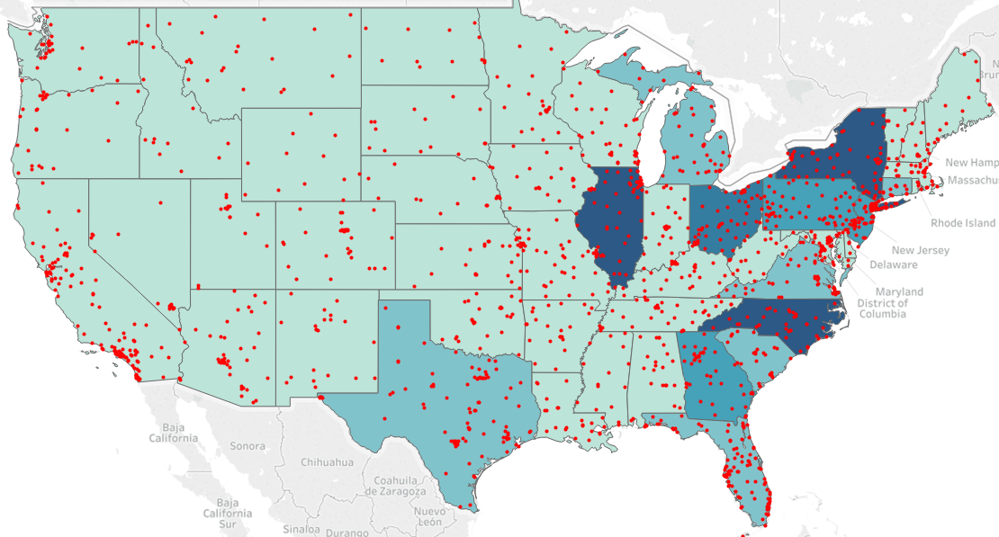
Target Population #2 – Predicted Veterans (22%)
6
All Identified Veterans(N=373,000)
Map: Top 3 Decile Membership by State (VA Facilities)*
Top 5 States
Gender
Males
Females
Tenure Months
Age Group
Members in the top 3 deciles resided in Illinois, North Carolina and the northeast region.
In those regions, there are numbers of VA hospitals, and it is more likely that veterans use VA facilities than private doctors.
Only predicted veterans would be included in the outreach, and predicted nonveteran would not be included.
Note:
* Color code represent the size of the membership within the region -- darker color indicate more members.
* Red dots represent the locations of VA hospitals or facilities
Notes:
Tables:

Slide 8
7
Veteran Performance Impact– Measure Level
Overall IVL MAPD Members vs Veterans vs Target Population (22%)
DOMAIN | MEASURE NAME | Overall IVL MAPD | Veterans | Target Population (Top 22% from the Model)
Member Counts |  | 1,556,820 | 9,312 | 373,000
HEDIS | Adult BMI | 68.99% (681,637) | 66.62% (1,381) | 63.10% (133,048)
HEDIS | Breast Cancer Screening | 68.73% (262,880) | 53.33% (45) | 36.52% (3,250)
HEDIS | Colorectal Cancer | 57.18% (595,781) | 41.20% (1,876) | 40.29% (150,462)
HEDIS | Diabetes - Blood Sugar Controlled | 31.06% (104,963) | 20.87% (877) | 24.24% (43,203)
HEDIS | Diabetes - Eye | 44.81% (151,448) | 27.82% (877) | 38.81% (43,203)
HEDIS | Diabetes - Kidney | 80.33% (271,507) | 71.49% (877) | 75.66% (43,203)
HEDIS | Osteo Screening | 28.51% (1,636) | NA (0) | 16.34% (728)
HEDIS | Rheumatoid Arthritis | 76.62% (8,506) | 65.00% (20) | 72.27% (1,367)
HEDIS | Statin Therapy for Patients with CD | 77.64% (53,899) | 52.35% (170) | 72.30% (13,104)
HEDIS | Medication Reconciliation Post Discharge | 78.98% (89,046) | 83.33% (270) | 87.92% (11,078)
Patient Safety | Medication Therapy Management | 53.98% (51,331) | 53.51% (114) | 55.50% (9,892)
Patient Safety | ACEI/ARB Adherence | 95.08% (625,442) | 94.89% (3,986) | 94.14% (88,580)
Patient Safety | Diabetes Adherence | 95.09% (594,713) | 94.17% (1,819) | 94.40% (33,754)
Patient Safety | Statin Adherence | 94.35% (218,702) | 95.19% (790) | 94.82% (95,308)
Patient Safety | Statin use in Diabetes | 95.04% (648,476) | 95.38% (2,057) | 76.42% (27,592)
Domain Performance
The target population has similar HEDIS and Patient Safety compliant rates. Veterans and the target population both performed lower in 7 of 13 measures when compared with the overall individual MAPD members.
Note:
1) The results are through 06/2020
2) Numbers in the parentheses are denominators for the measures

Slide 9
8
Predicted Veteran Performance Impact – Top States
Top 5 Target States vs overall IVL MAPD Members
Predicted Veteran & Age 65 + (N=287,000) |  |  |  |  |  | Overall IVL MAPD (N=1.6 Million)
Top 5 States | IL | NC | NY | GA | OH
Identified Veteran Counts | 531 | 488 | 595 | 467 | 533 | --
Predicted Veteran Counts | 30,095 | 29,700 | 28,849 | 15,745 | 15,597 | --
VA Facility Counts | 52 | 65 | 91 | 49 | 54 | --
Predicted Veterans Per VA Facility | 579 | 457 | 317 | 321 | 289 | --
Gender
Male (percent) | 15,396 (51.16%) | 15,757 (53.05%) | 14,245 (49.38%) | 8,823 (56.03%) | 8,619 (55.26%) | --
Female (percent) | 14,699 (48.84%) | 13,943 (46.95%) | 14,604 (50.62%) | 6,922 (43.96%) | 6,978 (44.74%) | --
Age | 75.1 | 73.5 | 74.1 | 73.6 | 74.2 | --
Tenure Month | 20 | 24 | 25 | 26 | 28 | --
Top County | COOK (6,751) | MECKLENBURG (2,835) | SUFFOLK (4,140) | GWINNETT (3,045) | FRANKLIN (13,431) | --
Top membership
Top 0 - 10% | 17,834 | 13,881 | 12,764 | 7,609 | 7,192 | --
Top 11 -20% | 11,090 | 13,113 | 13,501 | 6,044 | 6,766 | --
Top 21 - 22% | 1,171 | 2,706 | 2,584 | 2,092 | 1,639 | --
2020 YTD Key HEDIS Measures
Adult BMI | 48.80% (10,520) | 68.24% (12,599) | 51.99% (11,379) | 65.44% (6,585) | 78.46% (6,184) | 70.56% (580,298)
Breast Cancer Screening | 27.36% (380) | 35.57% (149) | 32.33% (133) | 28.66% (157) | 40.00% (105) | 65.84% (225,916)
Colorectal Cancer Screening | 39.71% (12,158) | 48.61% (14,466) | 37.10%(13,280) | 40.72% (8,039) | 43.35% (7,497) | 54.73% (605,808)
Diabetes - Blood Sugar Controlled | 16.44% (3,375) | 35.52% (4,169) | 21.90% (3,515) | 33.58% (1,849) | 24.66% (1,764) | 30.53% (208,985)
Diabetes - Eye | 43.38% (3,375) | 42.14% (4,169) | 42.61% (3,515) | 41.26% (1,849) | 39.68% (1,764) | 42.18% (208,985)
Diabetes - Kidney | 79.70% (3,375) | 78.77% (4,169) | 76.87% (3,515) | 73.76% (1,849) | 75.39% (1,764) | 82.76% (208,985)
2019 Key HEDIS Measures
Adult BMI | 62.49% (4,634) | 70.37% (3,581) | 56.61% (2,346) | 69.62% (2,887) | 82.64% (2,373) | 80.03% (375,446)
Breast Cancer Screening | 62.24% (641) | 61.87% (278) | 58.25 (218) | 57.94% (302) | 53.81% (236) | 75.02% (154,931)
Colorectal Cancer Screening | 64.83% (5,360) | 57.14% (4,200) | 51.82% (2,906) | 55.28% (912) | 57.23% (2,944) | 68.11% (380,442)
Diabetes - Blood Sugar Controlled | 40.27% (2,796) | 55.58% (3,215) | 45.72% (2,649) | 59.57 (1,531) | 53.70% (1,417) | 55.59% (149,673)
Diabetes - Eye | 68.24% (2,796) | 61.86% (3,215) | 68.74% (2,649) | 63.42% (1,531) | 57.80% (1,417) | 69.41% (149,673)
Diabetes - Kidney | 93.67% (2,796) | 93.15% (3,215) | 92.78% (2,649) | 91.31% (1,531) | 91.74% (1,417) | 94.47% (149,673)
Domain Performance
IL and NY are the two potential target markets since they both have lower performance in the key HEDIS measures comparing to the others.
Note:
1) The 2020 YTD results are through 06/2020
2) Numbers in the parentheses are denominators for the measures

Slide 10




9
Clustering Predicted Veterans – New York
Definition of High, Medium and Low Risk Members
Segmentation Definitions
Clustering
High Utilizer, High Needs and High Member Interactions:
Large population (N=19,138) with high medical costs and utilization, high distinct GPI, medium noncompliance rates in HEDIS and Patient Safety measures, high portion of HNG and high member interaction.
21.9 months of tenure and 73.9 years of age
Unsupervised
Machine Learning Algorithm
Low Utilizer, High Noncompliance rates in HEDIS and No Member Interactions:
Medium population (N=5,966) with low medical costs and utilization, low distinct GPI, high noncompliance rates in HEDIS and Patient Safety measures, low portion of HNG, and low member interaction.
30.1 months of tenure and 74.0 years of age
Predicted
Veterans
(N=28,849)
Medium Utilizer, Medium noncompliance rates, and Medium Member Interactions:
Small population(N=3,745) with medium medical costs and utilization, medium distinct GPI, medium compliance rates in HEDIS and Patient Safety measures, medium portion of HNG, and medium member interaction.
33.8 months of tenure and 74.5 years of age
Note:
HNG: High Need Group, members with 2 or more critical chronic conditions or with 6 or more general chronic conditions

Slide 11
10
Predicted Veteran Profiling – New York
Stratify the predicted veterans based on their health conditions, utilizations, demographic factors.
Recommendation:
Low Utilizer, High Noncompliance rates in HEDIS and No Member Interaction segment is the target group
Segment | Number of Predicted Veterans | Tenure (Months) | Distinct GPI | Age (Years) | Disability | High Need Group | Primary Care Physician | Total Medical Cost | Primary Care Visits | Call Counts | HEDIS Noncompliance Rates | Breast Cancer Screening – Noncompliant | Colorectal Cancer Screening- Noncompliant | Statin Adherence - Noncompliant
High Utilizer, High Needs and High Member Interaction | 19,138 | 22 | 5.07 | 73.9 | 2.3% | 34.1% | 34.2% | $4,033 | 2.55 | 4.85 | 32.55% | 43.75% (32) | 57.51% (8,834) | 6.85% (7,400)
Low Utilizer, High Noncompliance rates in HEDIS and No Member Interaction | 5,966 | 30 | 1.01 | 74.0 | 1.7% | 6.8% | 24.1% | $2 | 0.02 | 1.67 | 55.50% | 77.89% (95) | 77.02% (2,781) | 5.16% (697)
Medium Utilizer, Medium noncompliance rates, and Medium Member Interactions | 3,745 | 34 | 2.52 | 74.5 | 1.1% | 13.5% | 29.7% | $148 | 0.61 | 2.60 | 42.38% | 37.5% (8) | 67.50% (1,757) | 6.00% (983)
Total | 28,849 | 25 | 3.91 | 74.0 | 2.0% | 25.9% | 31.6% | $2,707 | 1.78 | 3.91 | 36.27% | 67.40% (135) | 62.88% (13,372) | 6.63% (9,080)

Slide 12
11
Socio-economic Profiling – New York
Stratify the regions based on the socio-economic variables from the census data.
Recommendation:
Low Education and Income with More Minority Ratio Segment is the target group
Segment | Number of Zip Codes | Disability Ratio | 20-50K Earnings Ratio | >50K Earnings Ratio | Higher Education Ratio | HH Food Stamps Ratio | HH Married Couple Ratio | HH Living Alone Ratio | Total Widowed / Divorced Ratio | Minority Race Ratio | Counts of VA Facilities
High Education and Income, with Less Minority Ratio | 407 | 9.1% | 19.8% | 53.2% | 51.1% | 5.6% | 11.5% | 31.7% | 13.4% | 4.5% | 21
Medium Education and Income with Less Minority Ratio | 1,207 | 12.5% | 28.8% | 30.3% | 25.1% | 0.7% | 16.5% | 28.5% | 16.2% | 4.8% | 50
Low Education and Income with More Minority Ratio | 170 | 11.8% | 29.4% | 26.6% | 22.7% | 2.2% | 31.8% | 29.4% | 14.1% | 38.3% | 14
Total | 1,784 | 11.2% | 26.1% | 36.4% | 32.2% | 0.7% | 19.5% | 29.8% | 14.9% | 15.6% | 84

Slide 13
12
Predicted Veteran vs Socio-Economic Profiling – New York
Predicted Veteran Profile
Segment | High Utilizer, High Needs and High Member Interaction | Low Utilizer, High Noncompliance rates in HEDIS and No Member Interaction | Medium Utilizer, Medium noncompliance rates, and Medium Member Interactions | Overall
High Education and Income, with Less Minority Ratio | 7,299 | 2,254 | 1,430 | 10,983
Medium Education and Income with Less Minority Ratio | 8,486 | 2,522 | 1,603 | 12,611
Low Education and Income with More Minority Ratio | 3,044 | 1,080 | 577 | 4,701
Overall | 18,829 | 5,856 | 3,610 | 28,295*
Ideal Target Group:
1,080 predicted veterans who have:
low medical utilizations and costs
high non-compliance rates
no member interactions including outbound calls and grievances
low income
low education
high minority ratio
1,080 predicted veterans live in 143 zip codes
Predicted Veteran Socio-economic Profile
Note:
There are 554 predicted veterans are not clustered into any socio-economic segments.
Total clustered + total non-clustered = total members
28,295+554= 28,849

Slide 14
13
Clustering Predicted Veterans – Illinois
Definition of High, Medium and Low Risk Members
Segmentation Definitions
Clustering
High Utilizer, High Needs and High Member Interactions:
Large population (N=20,556) with high medical costs and utilization, high distinct GPI, medium noncompliance rates in HEDIS and Patient Safety measures, high portion of HNG and high member interaction.
21.9 months of tenure and 73.9 years of age
Unsupervised
Machine Learning Algorithm
Low Utilizer, High Noncompliance rates in HEDIS and No Member Interactions:
Medium population (N=4,959) with low medical costs and utilization, low distinct GPI, high noncompliance rates in HEDIS and Patient Safety measures, low portion of HNG, and low member interaction.
30.1 months of tenure and 74.0 years of age
Predicted
Veterans
(N=30,095*)
Medium Utilizer, Medium noncompliance rates, and Medium Member Interactions:
Small population(N=4,248) with medium medical costs and utilization, medium distinct GPI, medium compliance rates in HEDIS and Patient Safety measures, medium portion of HNG, and medium member interaction.
33.8 months of tenure and 74.5 years of age
Note:
HNG: High Need Group, members with 2 or more critical chronic conditions or with 6 or more general chronic conditions
* There are 332 predicted veterans are not clustered into any segments.

Slide 15
14
Predicted Veteran Profiling – Illinois
Stratify the predicted veterans based on their health conditions, utilizations, demographic factors.
Recommendation:
Low Utilizer, High Noncompliance rates in HEDIS and No Member Interaction segment is the target group
Segment | Number of Predicted Veterans | Tenure (Months) | Distinct GPI | Age (Years) | Disability | High Need Group | Primary Care Physician | Total Medical Cost | Primary Care Visits | Call Counts | HEDIS Noncompliance Rates | Breast Cancer Screening – Noncompliant | Colorectal Cancer Screening- Noncompliant | Statin Adherence - Noncompliant
High Utilizer, High Needs and High Member Interaction | 20,556 | 19 | 5.93 | 75.3 | 1.6% | 25.1% | 6.5% | $4,356 | 2.76 | 1.92 | 29.04% | 47.62% (84) | 53.28% (7,986) | 4.40% (8,965)
Low Utilizer, High Noncompliance rates in HEDIS and No Member Interaction | 49,59 | 20 | 1.29 | 73.0 | 1.8% | 3.0% | 6.8% | $2 | 0.02 | 0.95 | 53.98% | 81.29% (262) | 79.03% (2,342) | 3.89% (720)
Medium Utilizer, Medium noncompliance rates, and Medium Member Interactions | 4,248 | 21 | 3.27 | 75.1 | 0.8% | 6.9% | 6.7% | $150 | 0.71 | 1.22 | 37.3% | 67.64% (34) | 66.92% (1,832) | 3.82% (1,465)
Total | 29,763 | 20 | 4.78 | 75.1 | 1.5% | 18.8% | 31.6% | $2,707 | 2.01 | 1.66 | 36.27% | 72.63% (380) | 60.29% (12,160) | 4.29% (11,150)
Note:
* There are 332 predicted veterans are not clustered into any segments.

Slide 16
15
Socio-economic Profiling – Illinois
Stratify the regions based on the socio-economic variables from the census data.
Recommendation:
Low Education and Income with More Minority Ratio Segment is the target group
Segment | Number of Zip Codes | Disability Ratio | 20-50K Earnings Ratio | >50K Earnings Ratio | Higher Education Ratio | HH Food Stamps Ratio | HH Married Couple Ratio | HH Living Alone Ratio | Total Widowed / Divorced Ratio | Minority Race Ratio | Counts of VA Facilities
High Education and Income, with Less Minority Ratio | 243 | 8.5% | 23.3% | 44.7% | 46.9% | 7.4% | 11.8% | 28.7% | 13.4% | 6.2% | 15
Medium Education and Income with Less Minority Ratio | 1,069 | 13.3% | 30.3% | 25.9% | 18.7% | 0.8% | 17.3% | 28.2% | 17.3% | 6.5% | 31
Low Education and Income with More Minority Ratio | 71 | 13.3% | 28.8% | 21.8% | 16.6% | 4.4% | 33.3% | 32.9% | 17.3% | 60.1% | 12
Total | 1,383 | 10.9% | 26.9% | 33.9% | 30.4% | 0.8% | 17.1% | 29.0% | 15.6% | 14.3% | 58

Slide 17
16
Predicted Veteran vs Socio-Economic Profiling – Illinois
Predicted Veteran Profile
Segment | High Utilizer, High Needs and High Member Interaction | Low Utilizer, High Noncompliance rates in HEDIS and No Member Interaction | Medium Utilizer, Medium noncompliance rates, and Medium Member Interactions | Overall
High Education and Income, with Less Minority Ratio | 6,203 | 1,649 | 1,355 | 9,207
Medium Education and Income with Less Minority Ratio | 12,254 | 2,762 | 2,443 | 17,459
Low Education and Income with More Minority Ratio | 2,099 | 548 | 450 | 3,097
Overall | 20,556 | 4,959 | 4,248 | 29,763*
Ideal Target Group:
548 predicted veterans who have:
low medical utilizations and costs
high non-compliance rates
no member interactions including outbound calls and grievances
low income
low education
high minority ratio
548 predicted veterans live in 59 zip codes
Predicted Veteran Socio-economic Profile
Note:
There are 332 predicted veterans are not clustered into any segments.
Total clustered + total non-clustered = total members
29,763+332= 30,095

Slide 18
Summary
17
Machine learning models were built with various data sources to predict the likelihood of being a veteran, and the model shows 94% accuracy on the test data.
There are some limitations in the models due to the data quality and availability, which include
1) 81% of the veterans are newly enrolled members, and the general MAPD population only has 36% of newly enrolled members.
2) 45% of the sampled nonveterans may not be truly nonveteran due to lack of information.
3) The model was built and scored using data as 06/2020, and the tables may get updated afterward.
Based on the scores of the model, a pilot would be rolling out to the selected cohort to verify their veteran status, and the results would be used to validate the model.
Notes:
Tables:

Slide 19
APPENDIX

Slide 20
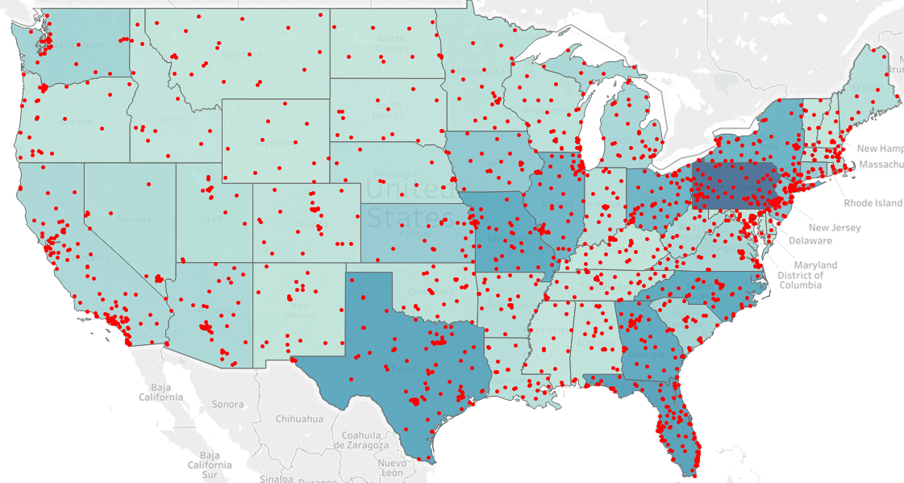
MAPD Overview
18
All MAPD Individual Members (N=1.6 Millions)
Map: MAPD Membership by State (VA Facilities)*
Top 5 States
Gender
Males
Females
Tenure Months
Age Group
Most of the general MAPD Members Pennsylvania, Florida and Texas.
Most VA Facilities are concentrated in the northeast region, Florida and California.
Note:
* Color code represent the size of the membership within the region -- darker color indicate more members.
* Red dots represent the locations of VA hospitals or facilities
Notes:
Tables:

Slide 21
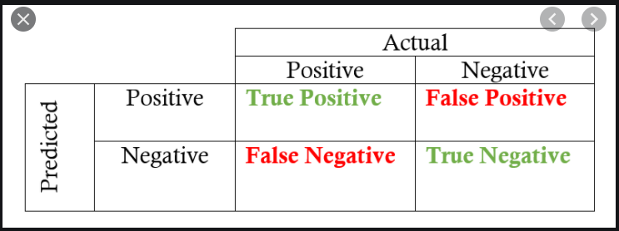
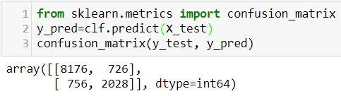
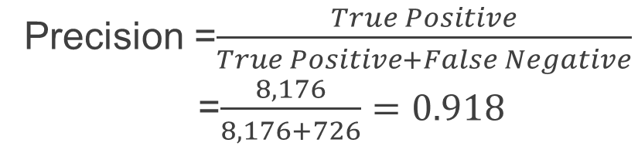
Confusion Matrix
19
Precision =$\frac{True Positive}{True Positive+False Negative}$
=$\frac{8,176}{8,176+726}=0.918$
Notes:
Tables:

Slide 22
Prediction Validation
20
Predicted veteran counts are higher than the actual counts based on the census data
Nationwide:
State | State Abbreviation | Population Age 65+ Year 2019 | Veteran Age 65+ Year 2019 | Actual Veteran Percentage | Aetna Membership 07/2020 | Predicted Veterans | Predicted Veterans Percentage
Total | -- | 54,074,028 | 8,770,424 | 16.2% | 1,577,187 | 341,102 | 21.6%
IL:
County Name | Population Age 65+ Year 2019 | Veteran Age 65+ Year 2019 | Actual Veteran Percentage | Aetna Membership 07/2020 | Predicted Veterans | Predicted Veterans Percentage
Total | 1,686,825 | 414,281 | 24.6% | 84,733 | 30,095 | 35.5%
NY:
County Name | Population Age 65+ Year 2019 | Veteran Age 65+ Year 2019 | Actual Veteran Percentage | Aetna Membership 07/2020 | Predicted Veterans | Predicted Veterans Percentage
Total | 3,091,779 | 590,806 | 19.1% | 89,746 | 28,849 | 33.7%
Notes:
Tables:

